Slide 1
Mass-suite: A novel Python package designed for mass spectrometry data analysis
Ximin Hu¹, Derek Mar⁴, Nozomi Suzuki⁴, Bowei Zhang⁴, David A. Beck³, Edward P. Kolodziej²
1. Civil and Environmental Engineering, University of Washington, Tacoma, WA, United States. 2. Sciences and Mathematics (UWT); Civil and Environmental Engineering (UWS), University of Washington (Tacoma/Seattle), Tacoma, WA, United States. 3. Chemical Engineering, University of Washington, Seattle, WA, United States. 4. Materials Science and Engineering, University of Washington, Seattle, WA, United States.

Slide 2
Introduction
Why Mass-suite
-Full-stack capability for Non-target data analysis
-Python is popular
-Flexible options
-Different angle of view
High Resolution Mass Spectrometry
-Novel technology
-Huge data
-Limited tools available
Pollutant in water
-Complicated in environment
-Challenge in identification and tracking
-Sketch for the source
Notes:
Novel technology for water quality assessment
Data massive for interpretation and detailed analysis
Current software hard to meet every needs
Different angle of views: rather than single/few compound, analyze the sample using feature groups/clusters to assess it Macroscopically

Slide 3










Overview of Mass-suite
data processing
Other tools
Essential functions for HRMS data processing:
Mzml import
Peak picking & Alignment
Blank subtraction
Data curation
More..
HRMS data processing assisting tools:
Formula annotation
MS2 spectrum online search
HRMS data quality report
More..
visualization
Always new
Various plot tools for visualizing HRMS data:
Chromatograms
Spectrums
Static/Interactive options
More..
Data mining
There are always something new:
Source identification
Source quantitative apportionment
MS2 data mining
Even more..
Explore HRMS data with data science tools:
Principle Component Analysis
T-SNE Dimension reduction
Clustering analysis based on DBSCAN/OPTICS
Various modeling options
More..

Slide 4
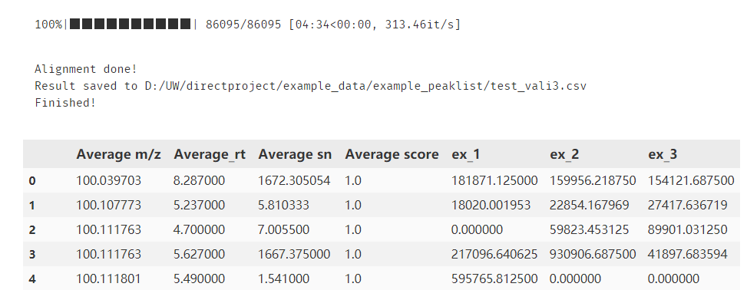
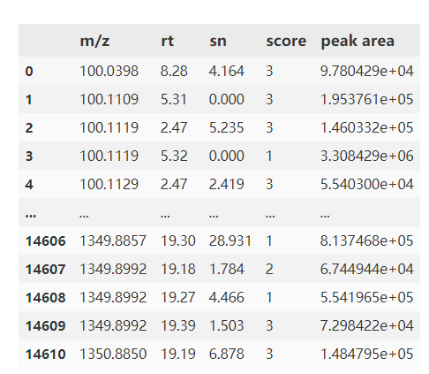
Example showcase
One-line option
mss_process(mzml folder,
output filename=‘align.csv’,
*param)
*param defines:
Minimal scan
Intensity filter
Mass error tolerance
Retention time tolerance
Etc.
Step-by-step option
scans = get_scans(filepath, *param) #noise removal noise_removal(scans, threshold=3000) #Generate peak list peak_list(scans, *param)
* Score calculated from randomforest model, built on 5000 training dataset

Slide 5
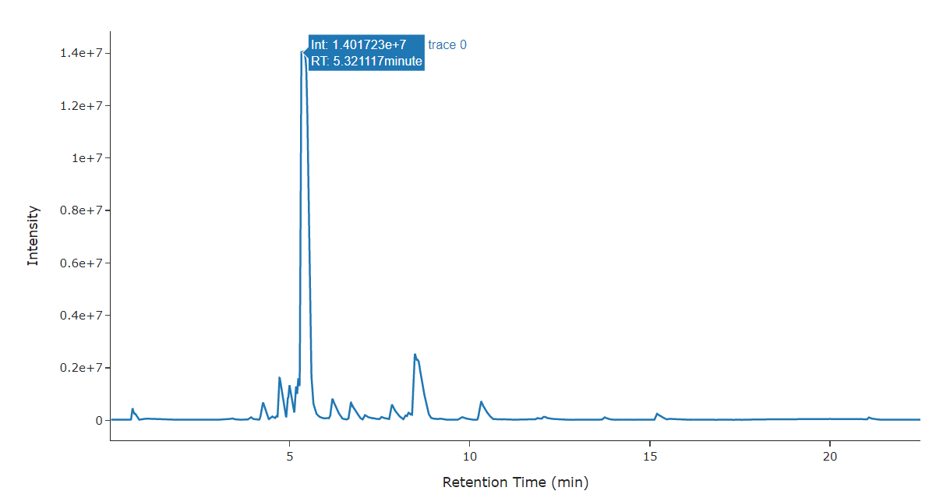
Example showcase
visreader.ms_chromatogram(mzmlfile,
formula/mass,
error tolerance=10,
search_online=True)
Other options:
TIC plot
MS spectrum (MS1 and MS2)
Isotopic plot
Peak Integration

Slide 6
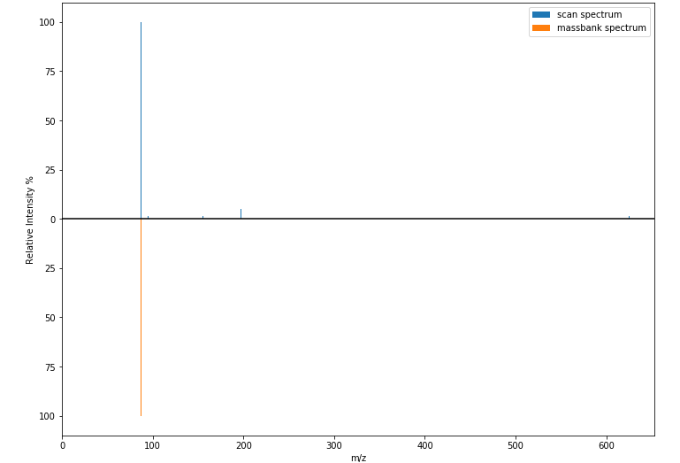
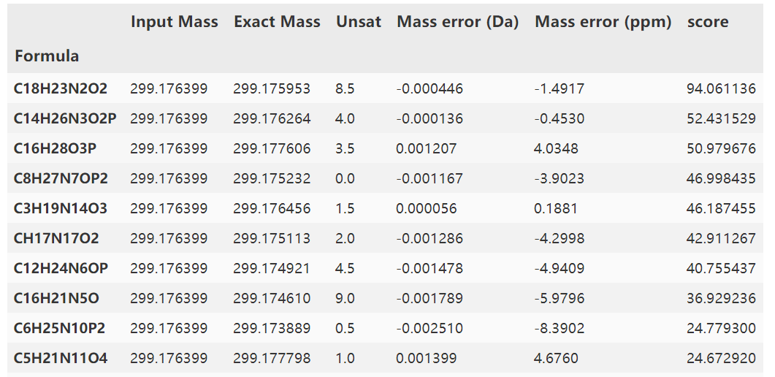
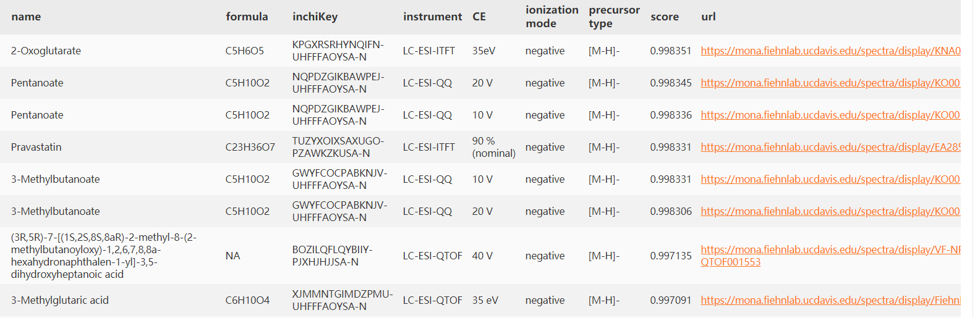
Formula annotation
Interactive plot for HRMS data visualization
Feature annotation
With online/in-house database

Slide 7
Reliability
Comparison between different software
Validation using in-house standards

Slide 8
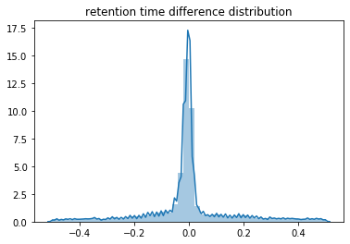
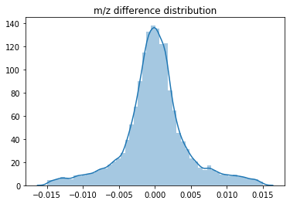
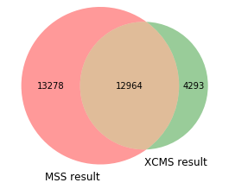
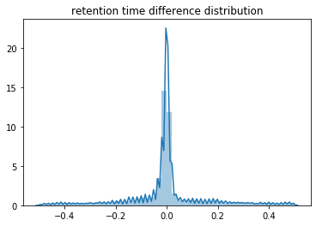
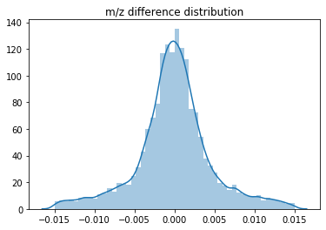
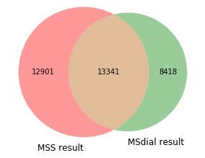
*Test done on the same sample (set of 3) with same parameter, XCMS processed on the web interface

Slide 9

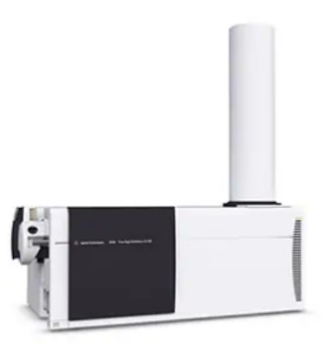

In house sample validation
Samples with 413 known compound spiked were processed by Mass-suite
* Mismatch derives from bad peak shape and function parameter settings

Slide 10
Data mining
Statistical analysis
Clustering analysis
Modeling analysis
Mass-suite provides capability for data mining on Non-target HRMS data

Slide 11
Statistical analysis
PCA/T-SNE
Hypothesis
testing
Volcano plot
Similarity comparison
Etc.
Basic statistical analysis based on built-in python functions:

Slide 12
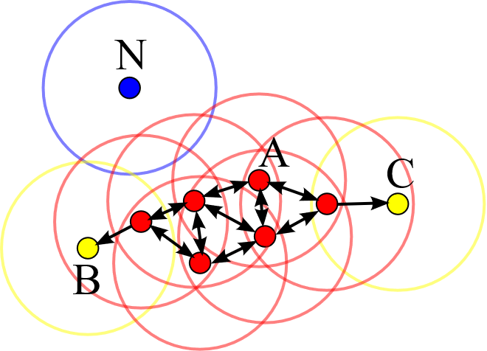
Clustering analysis
Based mainly on Density-based spatial clustering of applications with noise algorithm
Cluster the features with similar trend
Capture various trends rather than tedious ones
No need for detailed data comprehension
Such as cluster numbers or data shape assumptions
Could be coupled with other statistical tools
OPTICS algorithm as alternative
T-SNE or PCA, modeling analysis
Refined DBSCAN algorithm
Source: Wikipedia, https://en.wikipedia.org/wiki/DBSCAN

Slide 13
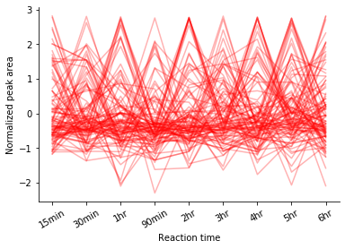
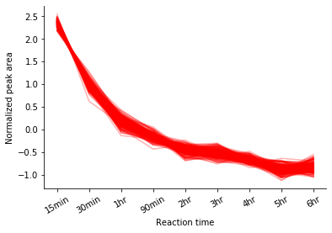
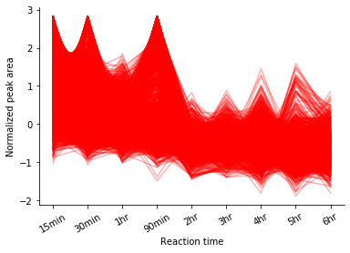
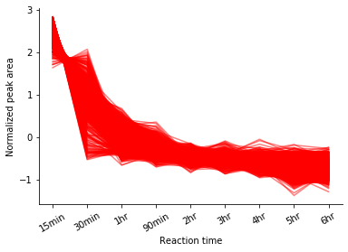
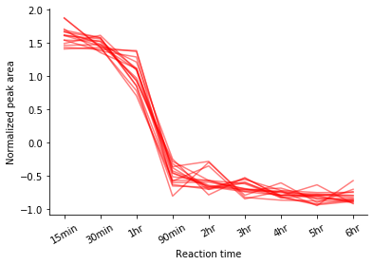
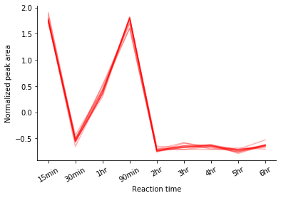
Distinguishing noise
Find similar features with error tolerance
Distinguish between different behaviors
* All data obtained from a time-series leaching experiment, normalization were conducted prior to clustering

Slide 14
Modeling analysis
Watershed mixtures*
Modeling analysis
Model options:
Linear regression
Lasso regression
Random Forest
SVM
…
Single chemical
Multiple clusters
Single cluster
Individual models
Ensemble method
Multivariate model
Single variate regression
100% highway runoff (SR520)
Coulter Creek in
→ 30% SR520
Kautz Creek in
→ 18% SR520
…
Field sample
→ ?% SR520
* Reference: Katherine T. Peter et al., Application of Nontarget High Resolution Mass Spectrometry Data to Quantitative Source Apportionment, Environmental Science & Technology 2019 53 (21), 12257-12268 DOI: 10.1021/acs.est.9b04481

Slide 15
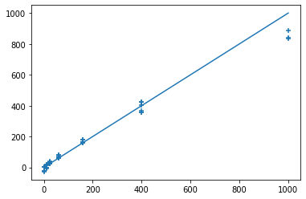
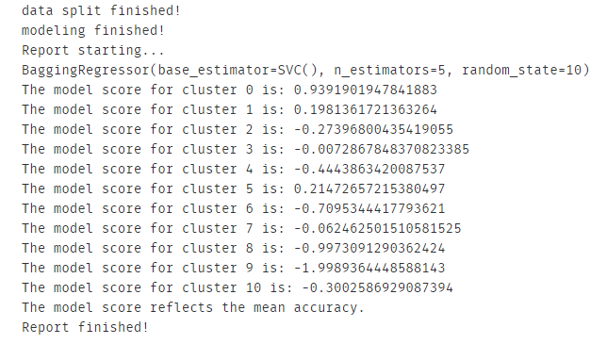
Modeling analysis
regression = feature_model(Data,
multiple_clusters=True,
model_method='ensemble_bagging_svc’,
report=True)
cluster_pred(regression,
Data,
sample_name=‘field1’,
selected_cluster=[0,1,3,5,7,9])
Predicted SR520 Vol. in 1000 mL sample (mL)
Actual SR520 Vol. in 1000 mL sample (mL)

Slide 16
Functionality Comparison
Tool Features | Mass-suite | TidyMS | MZmine2 | XCMS | MS-DIAL | Profinder & MPP
Language | Python | Python | Java | R | C#
Rawdata preprocessing | √ | √ | √ | √ | √ | √
QC-based batch correction | × | √ | × | × | × | ×
Quality reports | √ | √ | √ | × | √ | ×
Normalization, imputation, scaling | √ | √ | √ | × | √ | ×
Feature annotation | √ | × | √ | × | √ | √
Isotope grouping | × | × | √ | √ | √ | √
Interactive visualization plots | √ | × | √ | × | √ | √
Clustering statistical analysis | √ | × | × | × | × | ×
Modeling tools | √ | × | × | × | × | ×
* Functionality counted could be missing some features due to delay of software update
Reference: Riquelme G, Zabalegui N, Marchi P, Jones CM, Monge ME. A Python-Based Pipeline for Preprocessing LC-MS Data for Untargeted Metabolomics Workflows. Metabolites. 2020 Oct 16;10(10):416. doi: 10.3390/metabo10100416. PMID: 33081373; PMCID: PMC7602939.

Slide 17
Benchmarks
70%
Agreement on feature detection
As reliable as other platforms
99%
Accuracy of peak picking
With additional scoring based on RandomForest model
8 min/file*
Average processing time
Capable to be boosted up by supercomputers
4 Tools
Powering Non-target analysis
Based on data science approaches
30 Mb
Package size
Light for the installation and use
Open Source
Of the entire package
Keep updating, anyone can be involved
*Tested under default parameters as intensity cutoff = 3000, mz error = 10 ppm, alignment mz error = 10 ppm, rt error = 0.5 min, model_scoring was off, test were performed on personal laptop (Intel(R) Core(TM) i7-7700HQ CPU, 16GB RAM)
Notes:
Statistical tools, clustering tools, modeling tools and source identification tool (in dev)

Slide 18
Roadmap
Annotation tool development
Dynamically update according to needs
Understand chemical commonality found by tools
1
3
5
2
4
6
Source identification analysis
GUI/web tool development
Even more…

Slide 19

Related information
Installation:
https://pypi.org/project/mass-suite/
Github page & documentation:
https://github.com/XiminHu/mass-suite
Contact:
xhu66@uw.edu
Suggestions & Collaborations
are always welcome !

Slide 20
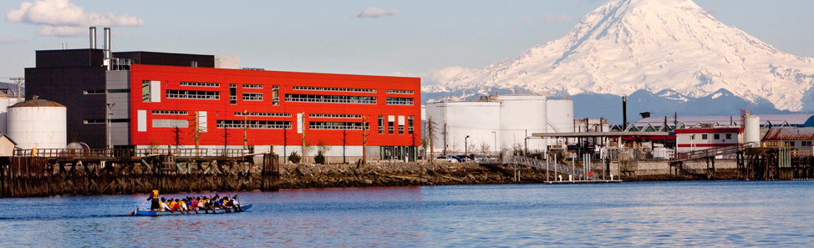

Acknowledgement:
A big shout to Professor Edward Kolodziej, Professor Dave Beck, Dr. Katherine Peter, and the Center of Urban Water for all their help during the development of this package.

Slide 21
References & dependencies
M Kösters et al; pymzML v2.0: introducing a highly compressed and seekable gzip format, Bioinformatics, doi: https://doi.org/10.1093/bioinformatics/bty046
Pedregosa et al., Scikit-learn: Machine Learning in Python, JMLR 12, pp. 2825-2830, 2011.
Martin Ester et al. 1996. A density-based algorithm for discovering clusters in large spatial databases with noise. In Proceedings of the Second International Conference on Knowledge Discovery and Data Mining (KDD'96). AAAI Press, 226–231.
Riquelme G et al. A Python-Based Pipeline for Preprocessing LC-MS Data for Untargeted Metabolomics Workflows. Metabolites. 2020 Oct 16;10(10):416. doi: 10.3390/metabo10100416. PMID: 33081373; PMCID: PMC7602939.
Tsugawa, Hiroshi et al. “MS-DIAL: data-independent MS/MS deconvolution for comprehensive metabolome analysis.” Nature methods vol. 12,6 (2015): 523-6. doi:10.1038/nmeth.3393
Horai, H. et al (2010), MassBank: a public repository for sharing mass spectral data for life sciences. J. Mass Spectrom., 45: 703-714. https://doi.org/10.1002/jms.1777
Katherine T. Peter et al., Application of Nontarget High Resolution Mass Spectrometry Data to Quantitative Source Apportionment, Environmental Science & Technology 2019 53 (21), 12257-12268 DOI: 10.1021/acs.est.9b04481
Mass-suite requires major dependencies:
Pandas 1.0.3 or higher
Numpy 1.16.5 or higher
Scikit-learn 0.23.0 or higher
Scipy 1.4.1 or higher
pymzml 2.4.6 or higher
PeakUtils 1.3.3 or higher
plotly 4.5.2 or higher
Optional dependencies for machine-learning:
Keras 2.3.1
Tensorflow 2.0.0
Pytorch 1.4.0 or higher

Slide 22

Thanks!

